Slide 1

Introduction to Excel
Office 365 Offers 2 Options
-the desktop application
-the online option

Slide 2
What is Excel?
A tool for organizing and performing calculations on data.
It can
  analyze data,
  calculate statistics,
  generate pivot tables,
  and represent data as a chart or graph.
Used to create spreadsheets.

Slide 3
Spreadsheets
Documents where data is laid out in rows and columns.
  Much like a big table.
They data to make it simpler to read and manipulate.
Spreadsheets are extraordinarily powerful tools, and are used frequently in the business world to store and manipulate data.

Slide 4
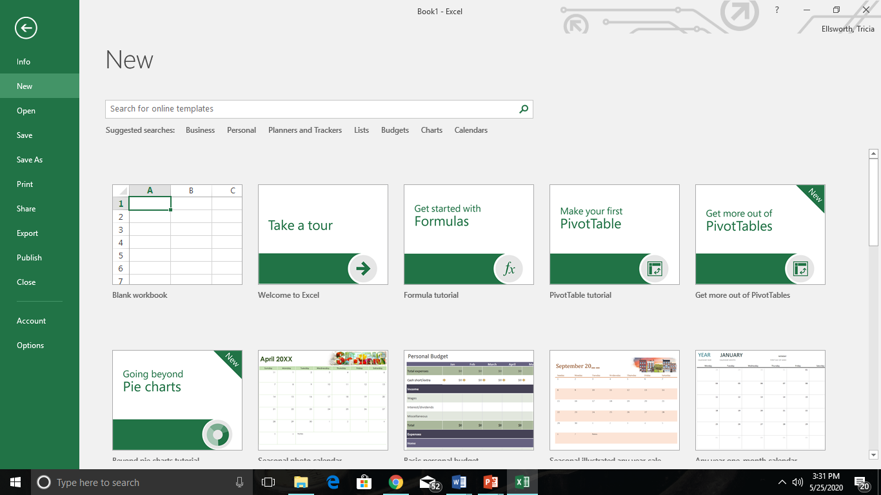
File Tab
Always SAVE FIRST!
  File - Save as
  Even before starting to create it, save it to O365.
  Then you won’t lose work if your computer dies.
The first time you open MS PowerPoint you may need to log in with your Office 365 credentials.
  Email address
  Password
Continue saving (control s) as you make changes to your presentation.

Slide 5
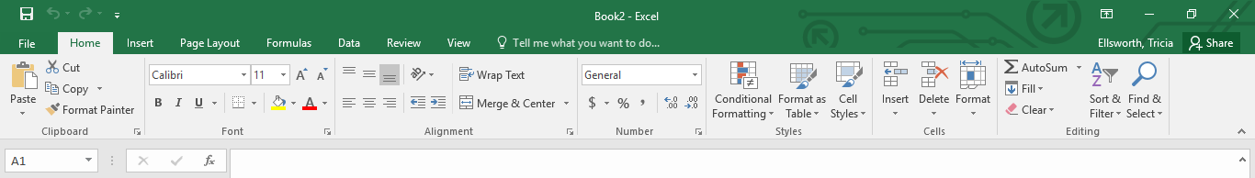
Home Tab
Alignment – how data fits in cells
Number – format numbers to $, % etc.
Styles – Setting up cell and table styles
Cells – Format, insert, delete
The same as MS Word & MS PowerPoint
  Clipboard
  Font
  Alignment
  Editing

Slide 6
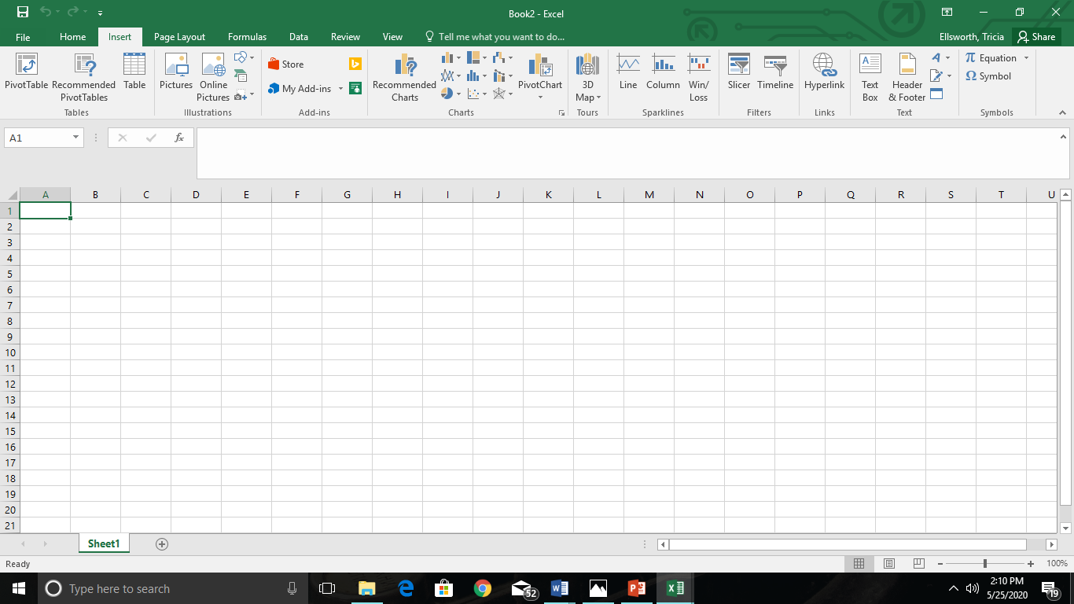
Insert Tab
Very similar to MS Word & MS PowerPoint
  Tables
  Illustrations
    Pictures
  Charts
  Text Boxes
  Word Art
  Header/Footer
  Symbols

Slide 7
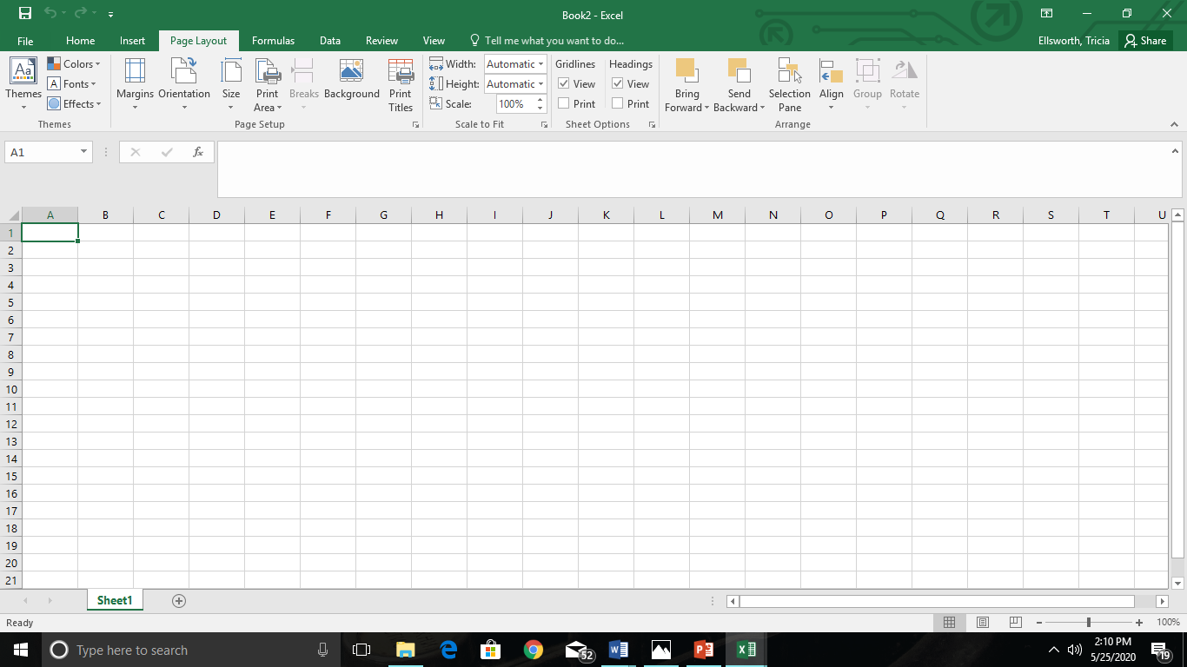
Page Layout Tab
Again, very similar to MS Word & MS PowerPoint
  Themes
  Page Setup
  Scale to fit
  Arrange

Slide 8
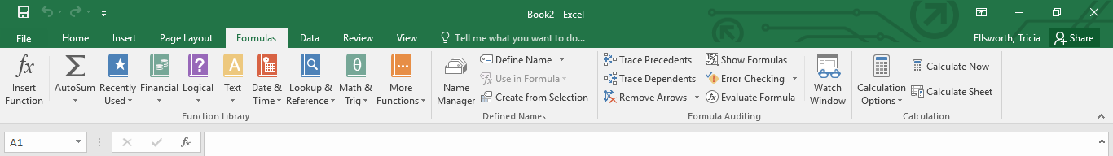
Formula Tab
Designed specifically for MS Excel
Special Features
  Function library
  Defined names
  Formula adjusting
  Calculation

Slide 9
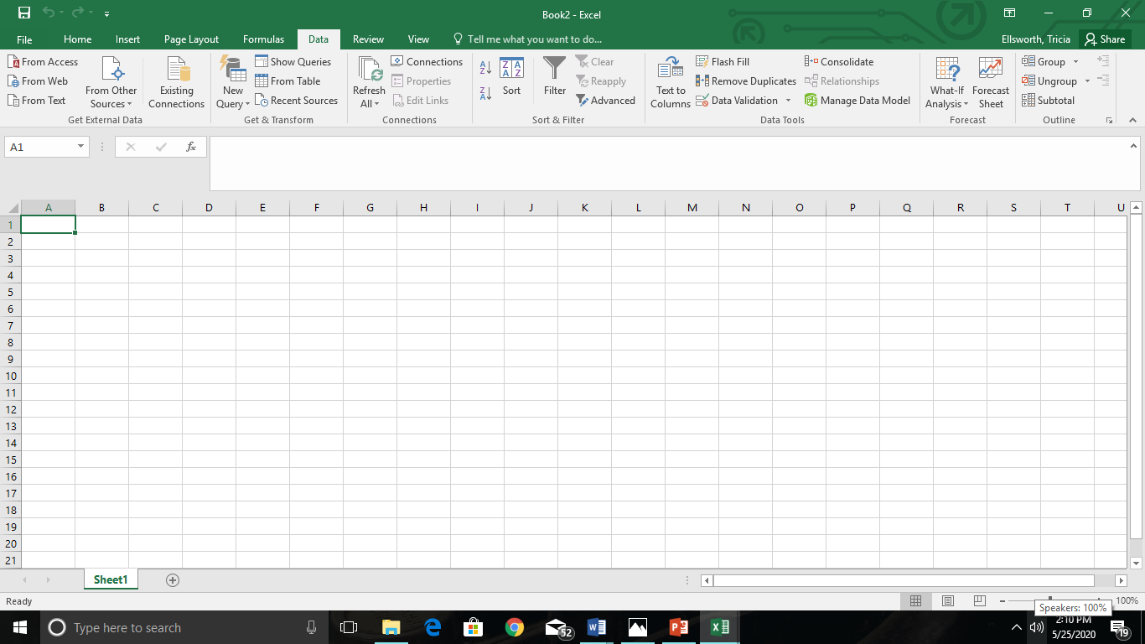
Data Tab
Also specially designed for MS Excel
More Advanced Features
  Get external data
  Get and transform
  Connections
  Sort and filter
  Data tools
  Forecast
  Outline

Slide 10
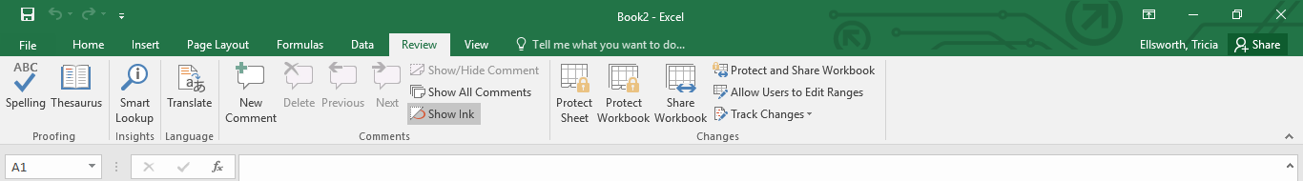
Review Tab
Very similar to MS Word.
This is where you can find
  Spell Check
  Thesaurus
  Language

Slide 11
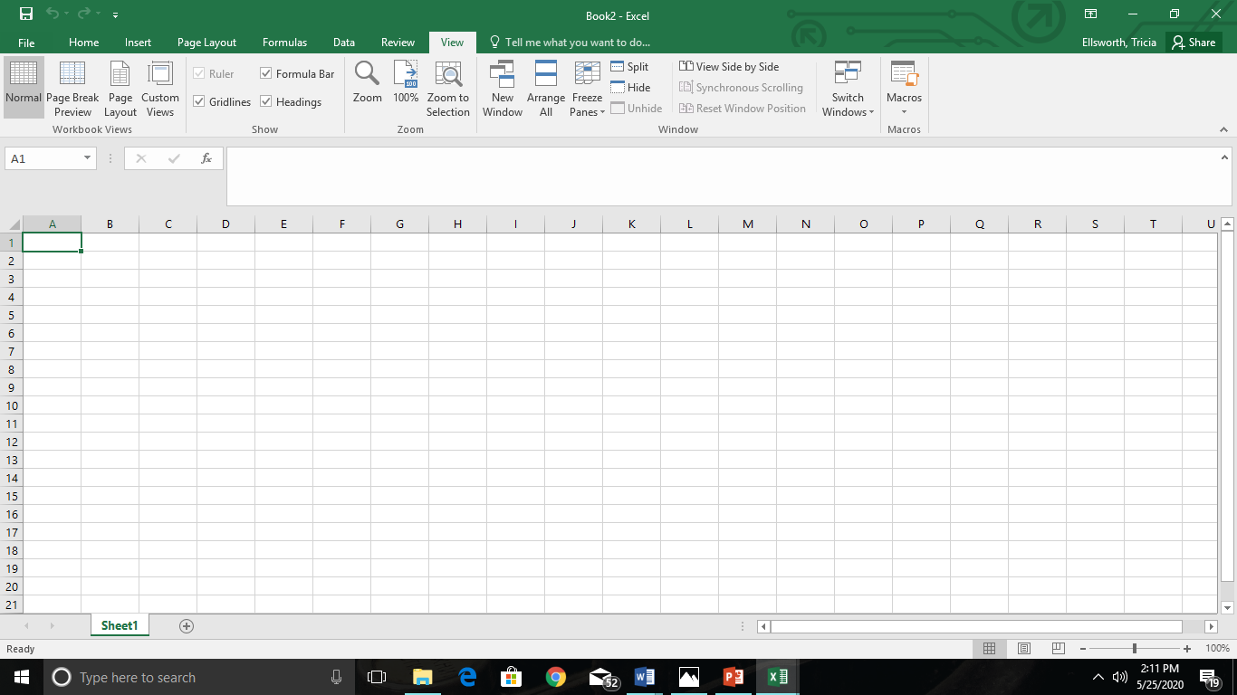
View Tab
Workbook Viewers
Show
  Ruler
  Formula Bar
  Gridlines
  Headings
Zoom
Window

Slide 12
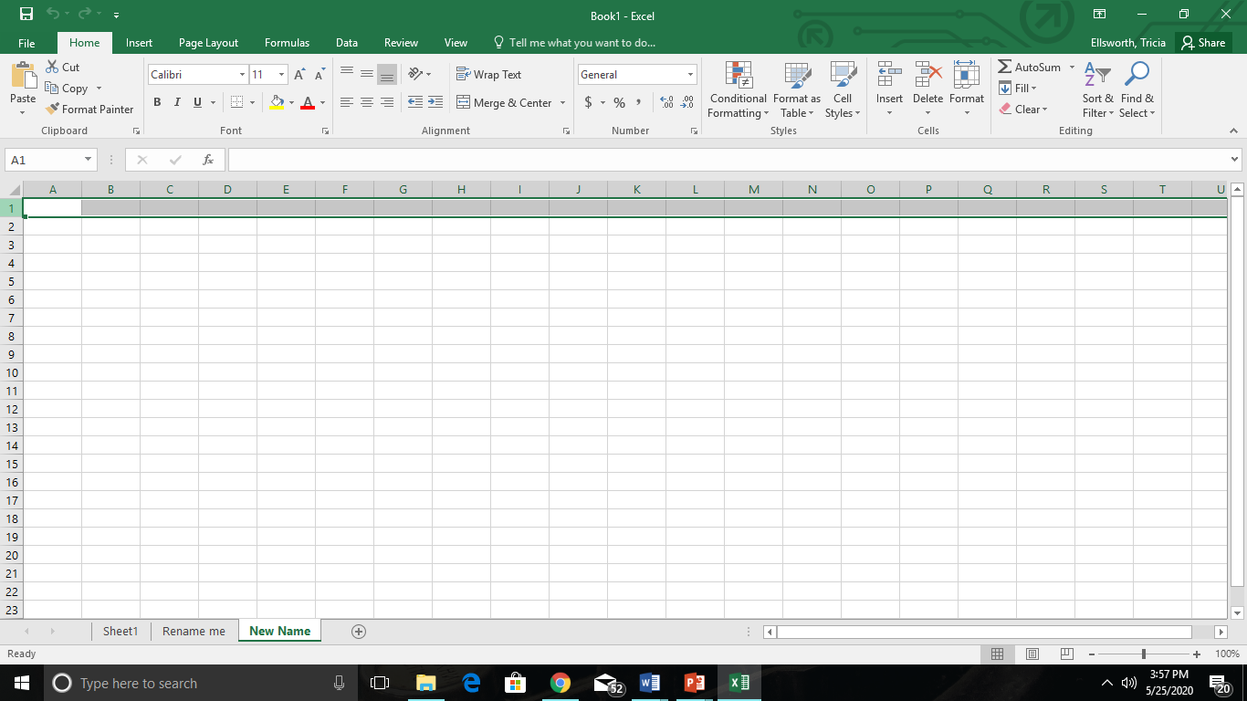
Row
Given numeric labels.
Rows run left to right.
  Like a row in a garden.

Slide 13
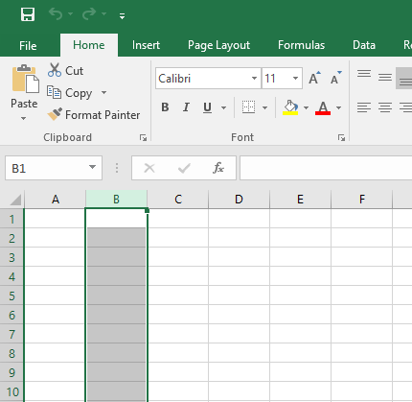
Column
Given alphabetic labels.
Columns go from top to bottom.
  Like a column that holds up a roof

Slide 14
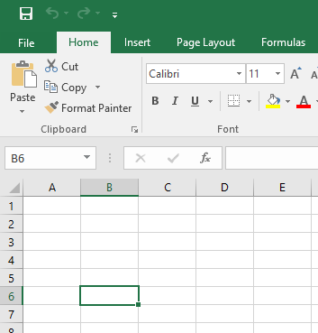
Cell
Where a row and column intersect.
Both Numeric and alphabetic.
  Coordinates like the game Battleship.

Slide 15
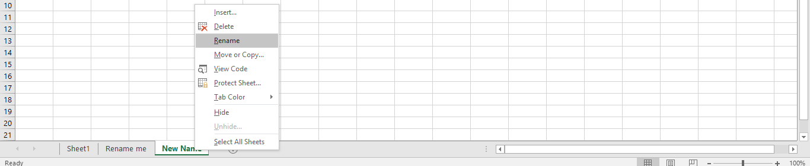
Sheets
You can add many sheets to your document.
  Much like tabs in your notebook.
Rename your sheets so you know what is on them
  Right click
  Rename

Slide 16
EXCEL CURSORS
There are four different types of cursors in Excel.
Understanding these cursors will make using Excel a lot easier.
The cursor is the way your mouse looks on the screen.

Slide 17
Autosum
This button can add many numbers in a row or many numbers in a column.

Slide 18
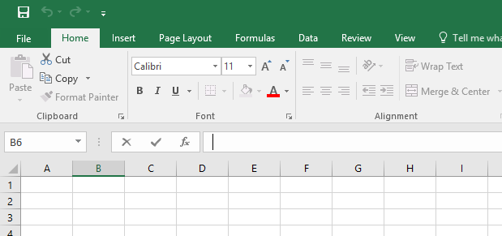
Formula Bar
This is where you make changes to what is in the cell.

Slide 19
Select
You can click to select one cell or click and drag to highlight many cells.

Slide 20

Drag Cell
You will see this cursor when you put the mouse on the black line of a selected cell.
You can click and drag the whole cell to a different place on the sheet.

Slide 21
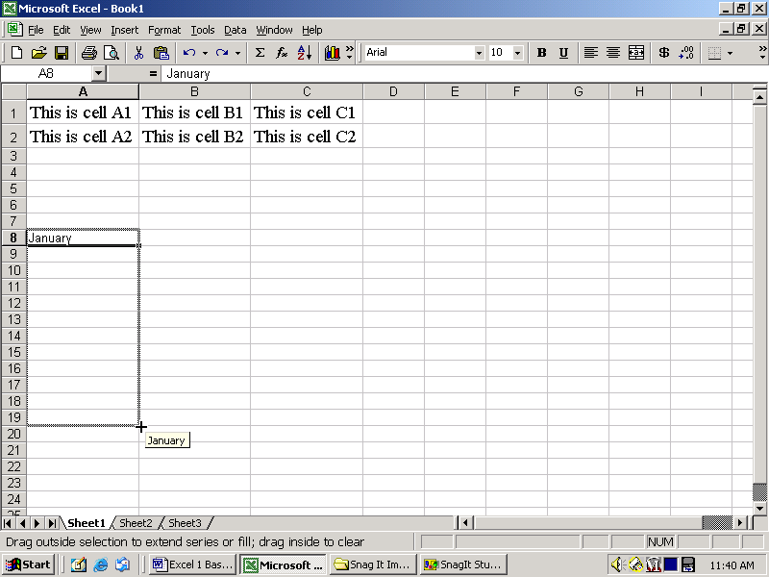
Auto Fill
You will see this cursor when you put the mouse on the bottom-right corner of a selected cell.
You can click and drag to complete a list.

Slide 22
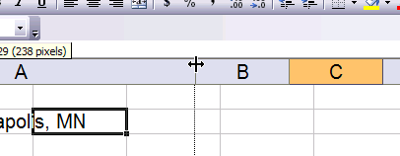
Change Size (columns and rows)
You will see this cursor when you put the mouse between the column labels.
You can click and drag to make the columns and rows bigger or smaller.

Slide 23
Don’t Forget Your Shortcuts
Ctrl w – close a spreadsheet
Ctrl o – open a spreadsheet
Ctrl s – save
Ctrl a – selects all
Ctrl z - undo
Ctrl c - copy
Ctrl x – cut
Ctrl v – paste
Ctrl p – print

Slide 24
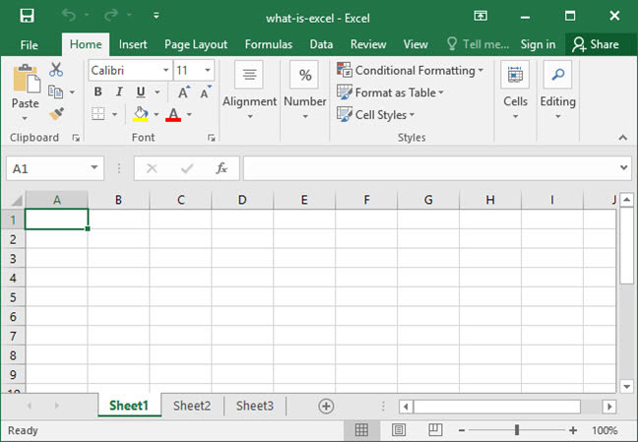
Looking at a Spreadsheet
The document is comprised of columns and rows.
At the intersection of each row and column is a cell where a user can enter either numbers or text.
The address of any given cell is created by combining the letter of the cell's column with the number of the cell's row.
The cell highlighted to the right is at address B4, because it lies at the intersection of column B and row 4.
  we call it, "Cell B4."

